Slide 1
Capstone 1
Online Shopping system

Slide 2
CONTENT
Methods
Add To Cart
Display cart
Checkout
User buy (related method)
Code Segements

Slide 3
Add to cart
Add to cart method takes objects of type Product and add them to an arrayList of type Product in the user class model, method return type is integer and the method take three parameters user ID, prodcut ID and the amount of the product (stock), the method check if the given IDs are valid and check if the product is in stock, if all conditions to add a product to a user cart are met then add product/s to the user cart.

Slide 4
Display cart
Method display take user ID in the parameter, then search if the user exist and if the user exist return user cart which is an ArrayList of type Product .

Slide 5
Checkout
Checkout method takes in three parameters which are user ID, product ID and merchant ID. Then the method call another method which is userBuy and pass the three parameters to it and save the return value in a char variable named check, Then search for the user and check if the cart is empty or not, last remove purchased products form the cart.

Slide 6
Related methods
User buy method
The user buy method check if the user cart is empty or not, if it’s empty then continue the method and buy directly without a user cart and deduct the price from the user balance.

Slide 7
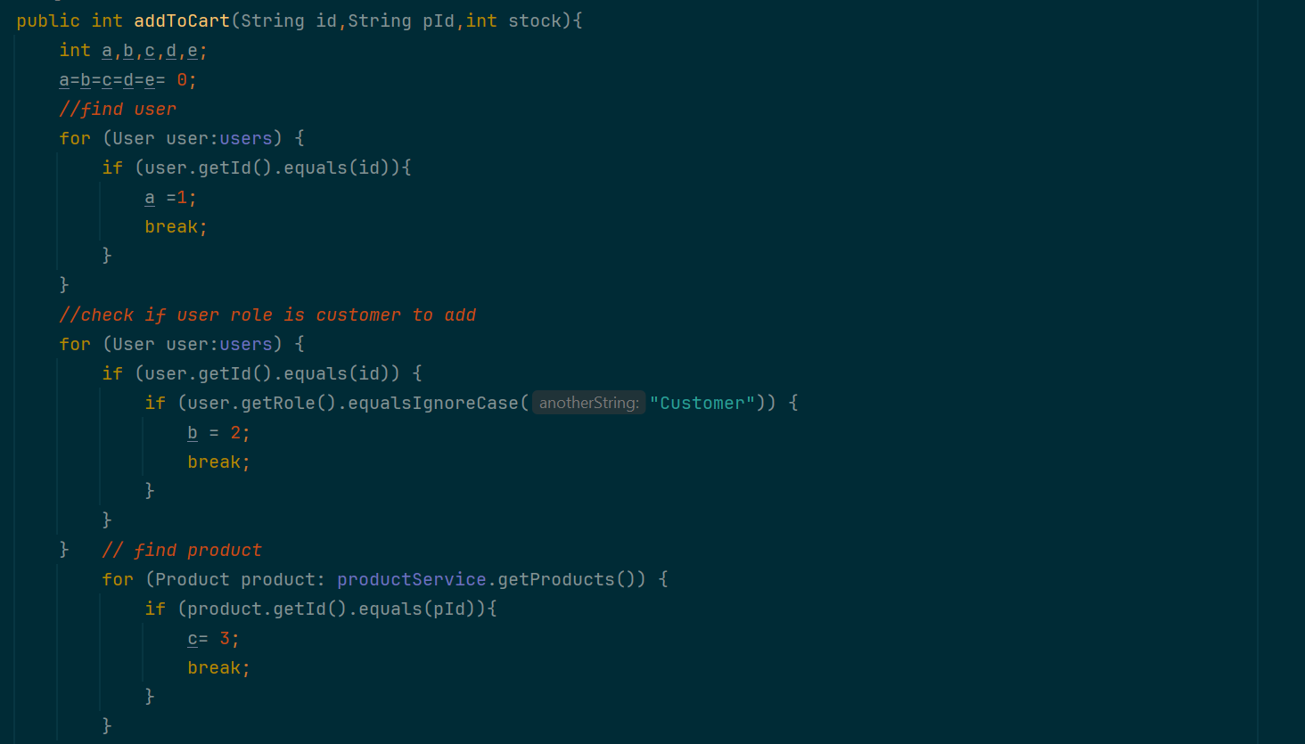
Code Segments
Add to cart

Slide 8
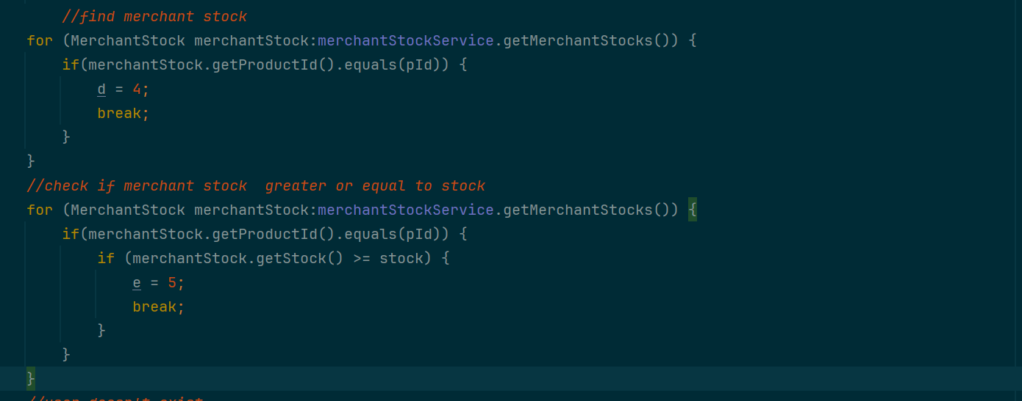

Slide 9
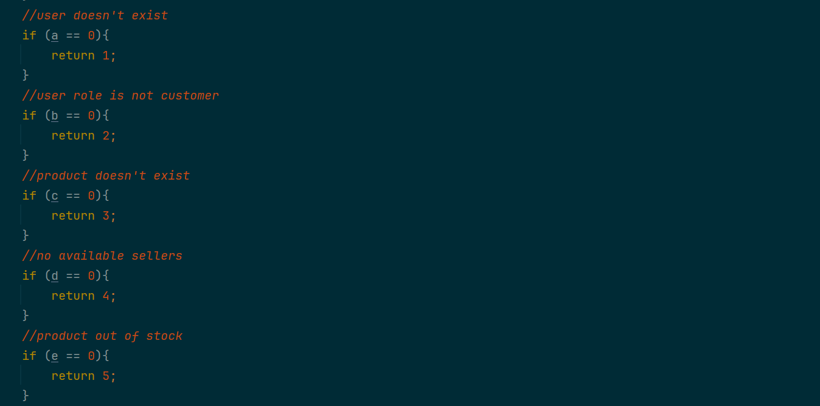

Slide 10
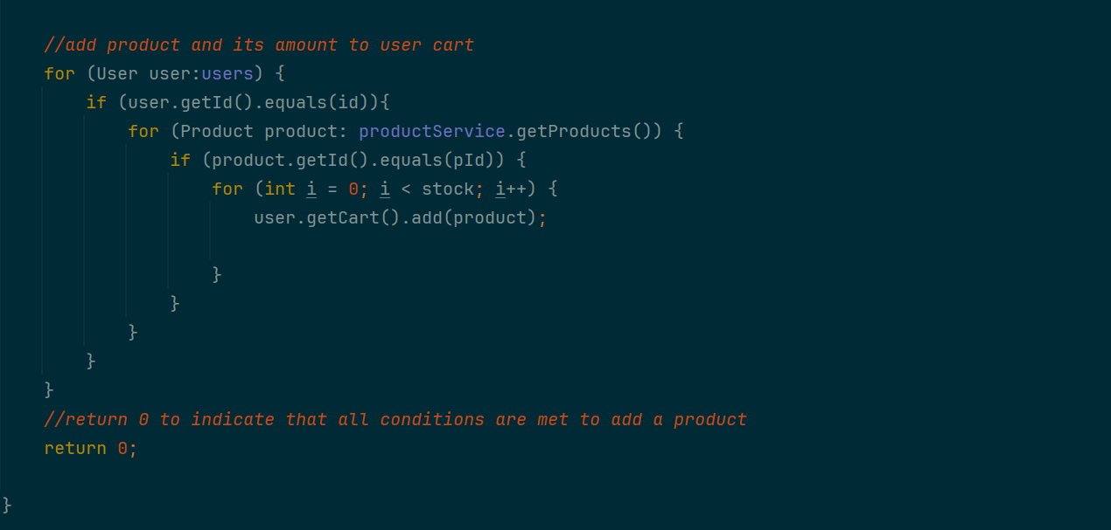

Slide 11
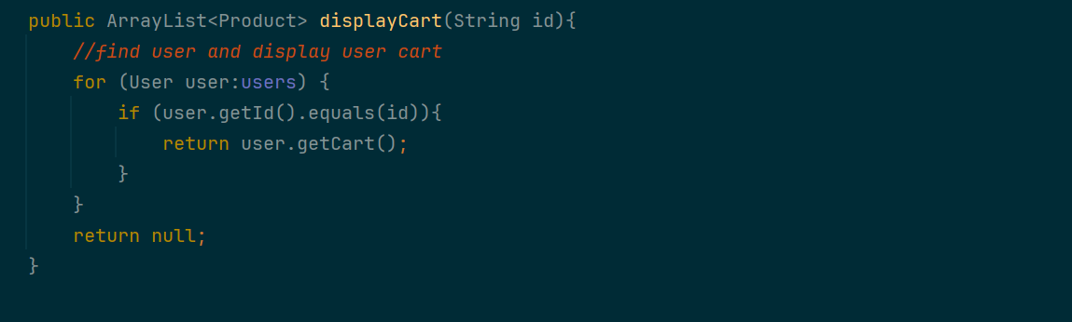
Display cart

Slide 12
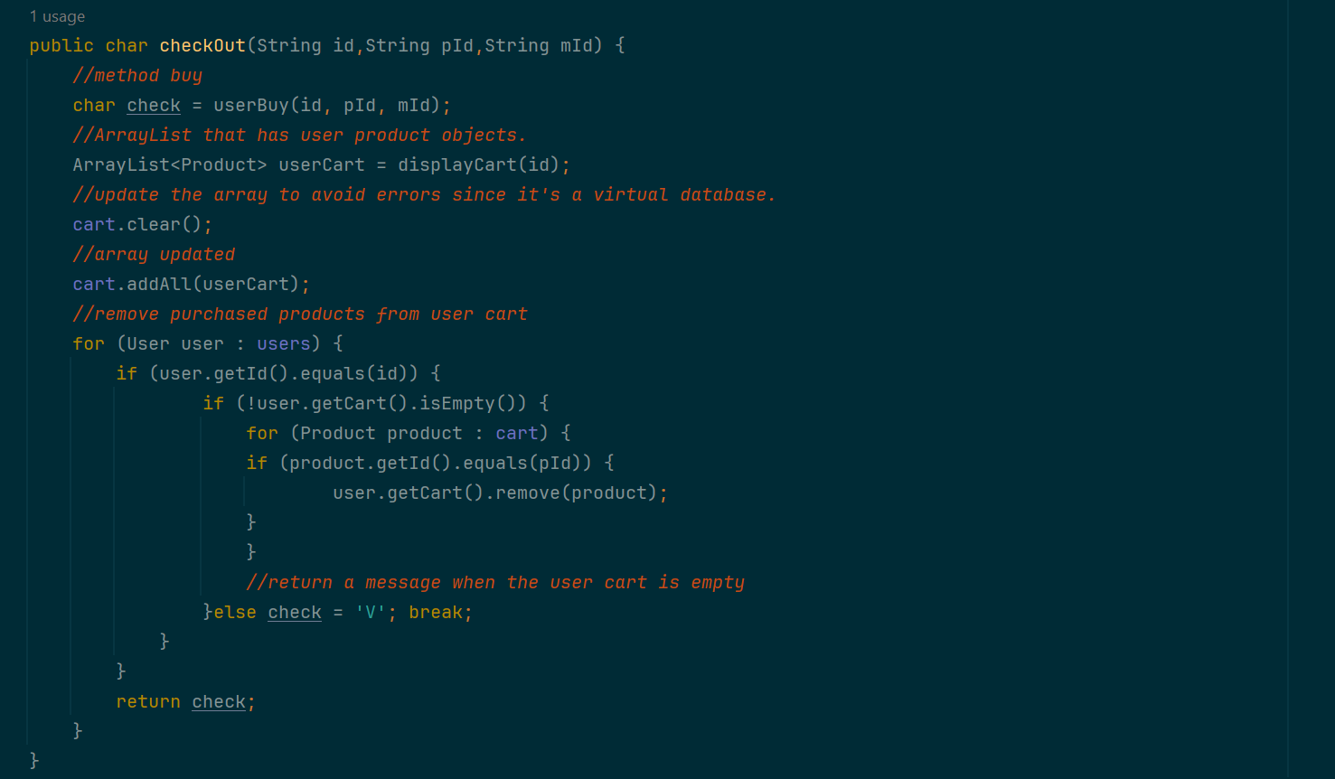
Checkout

Slide 13
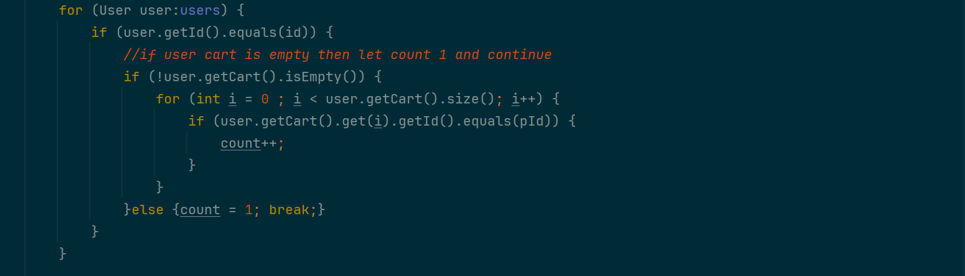
User Buy

Slide 14
Thank you for listening
Bader Alshehri

